Slide 1
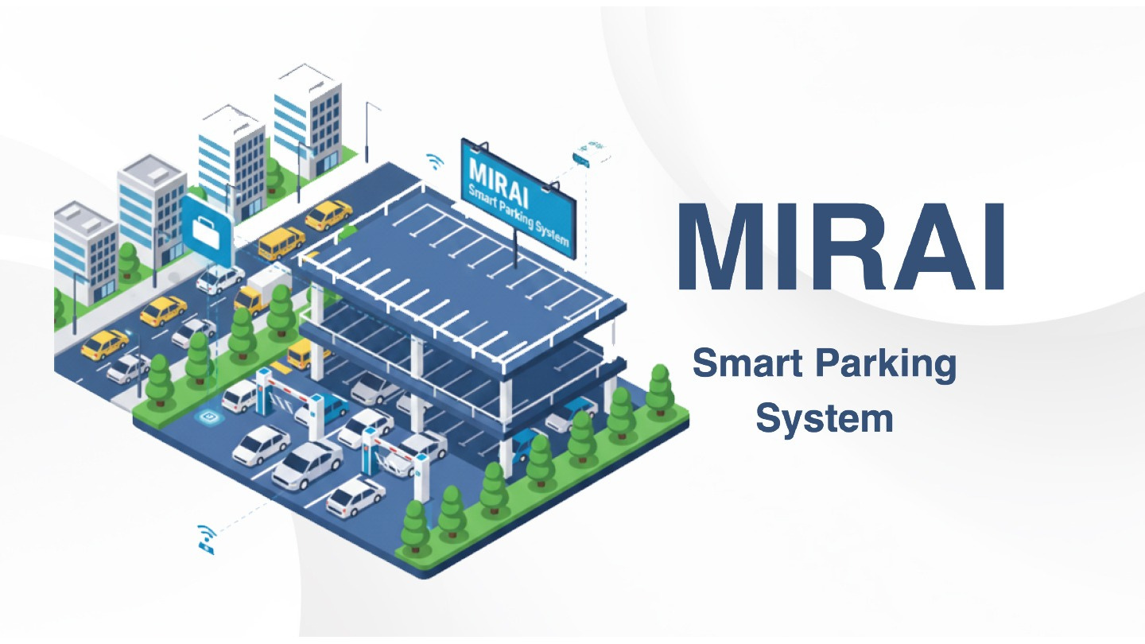
1

Slide 2






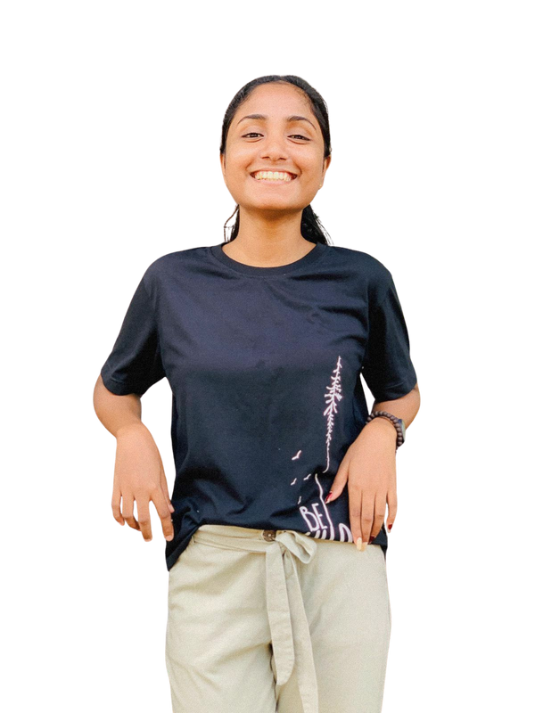
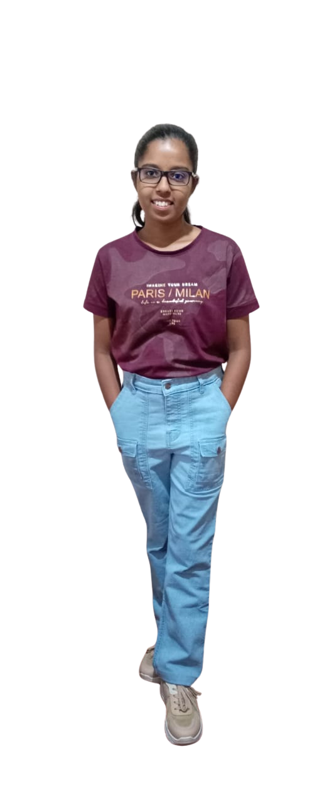
Group Members
IT25103890
IT25103894
IT25103892
Randil P.M.L.
Ranasinghe K. S. S.
Usman M. N. M.
IT25103893
IT25103889
IT25103891
Chandrasekara P. V. A.
Edirisinghe U. K.
Malshika U. L. J.
2

Slide 3

Project Background
Parking has become difficult as vehicle numbers keep increasing. Manual ticket systems are slow and cause delays. Using RFID and sensors can make parking faster and easier. Our system identifies vehicles automatically and shows free slots in real-time, making parking smoother and more efficient.
3

Slide 4

Problem and Motivation
  Problem
  Manual parking is slow and doesn’t show real-time slot availability. This causes congestion, delays, and errors in billing and access.
  Motivation
  A smart automated system can save time, reduce traffic, and improve accuracy and security using RFID and IoT.
4

Slide 5
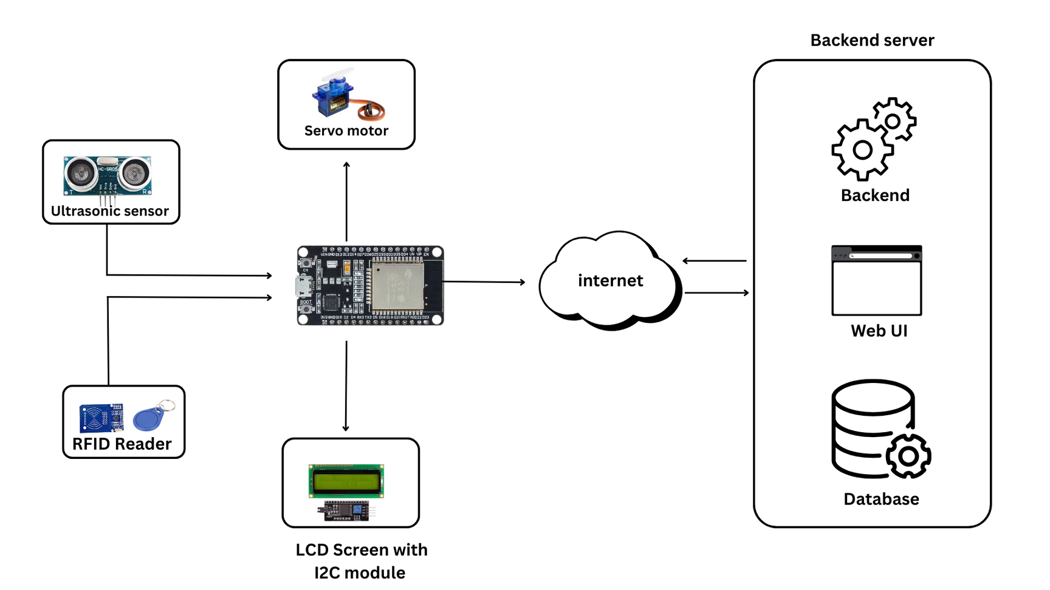
System Diagram
5

Slide 6

Methodology
  Requirement Analysis and Planning
  System Design
  Development
  Testing and Quality Assurance
  Deployment and Integration
6

Slide 7

Evaluation Method
  Unit testing
  Integration Testing
  Security Checks
  Data Integrity Testing
  System Testing
  Performance Testing
7

Slide 8

Conclusion
8

Slide 9
Thank You !
9

